Slide 1
Understanding Color and Color Schemes (How, When, Where, Why)

Slide 2
Essential Questions
What effect does context have on our perception of color?
How do artists use color as an expressive element in works of art?
How has the nature and use of color in works of art changed over time?

Slide 3
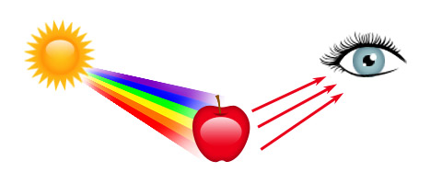
Hue, Value, and Intensity
Color
An element of art that is derived from reflected light. You see color because light waves are reflected from objects in to our eyes.

Slide 4
Hue, Value, and Intensity
Hue
The name of a color in the color spectrum, such as red, blue, or yellow.
Primary Hues: Red, Blue, Yellow
Secondary Hues: Green, Orange, Violet
Intermediate Hues: Six colors made by mixing primary and secondary hues
Example: Red-Violet, Blue-Green, Yellow-Orange

Slide 5
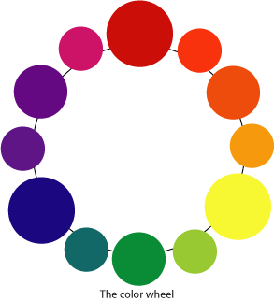
Color Wheel
The color spectrum bent into a circle

Slide 6
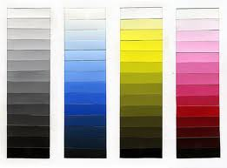
Hue, Value, and Intensity
Value
The art element that describes the darkness or lightness of a color.
Tint: Changing the value of a color by adding white.
Shade: Changing the value of a color by adding black.

Slide 7
Hue, Value, and Intensity
Intensity
The brightness or dullness of a hue. Bright hues are called high intensity while dull hues are called low intensity colors.
Mixing a tint (W) with a hue = decreased intensity
Mixing a shade (B) with a hue = decreased intensity
Mixing complementary colors = same intensity
Complementary Colors: The colors opposite each other on the color wheel. The compliment, or opposite, of a hue absorbs all of the light waves that the hue reflects.

Slide 8
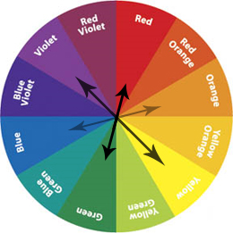
Compliments are opposite each other on the color wheel:

Slide 9
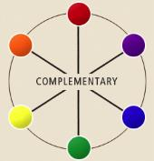
Color Theory Examples
Chart 1 - HUES (pure colors from wheel)
Chart 2 – TINTS (1 color + white only)
Chart 3 – SHADES (1 color + black only)
Chart 4 – COMPLEMENTARY (use 1 set of complementary colors only)

Slide 10
Color Schemes
A color scheme is a system of organizing colors.
A color scheme deals with pairing colors in order to create a specific mood or atmosphere.

Slide 11
Color Schemes
Warm and Cool Colors
Cool colors: Blue, Green, Violet
Cool colors seem to recede or move into the distance
Warm colors: Red, Yellow, Orange
Warm colors seem to move toward the viewer

Slide 12
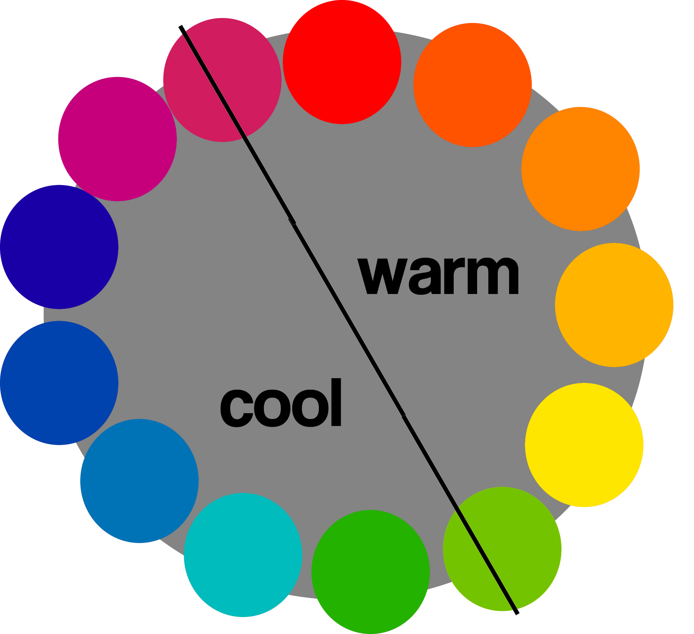

Slide 13
Color Schemes
Monochromatic Colors
Monochrome means “one color” (mono = one, chroma = color).
A monochromatic color scheme is one that uses one hue and the tints and shades of that hue.

Slide 14
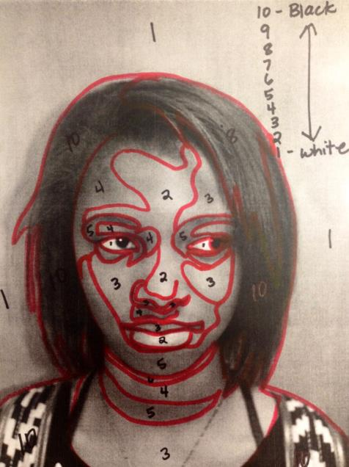
Monochromatic Portrait: How To Approach It
Get portrait from Mr Uhl
Use a bright-colored marker to outline the shapes of value
Number the shapes with 1 being the lightest color and 10 being the darkest color
Use a COOL color for your monochromatic scheme (blue, purple, or green)

Slide 15
Warm Up
Come in
Get a paint tray and a watercup for your table
Get out your portrait or your shoe
Be prepared to stop so I can explain the next painting assignment to you

Slide 16
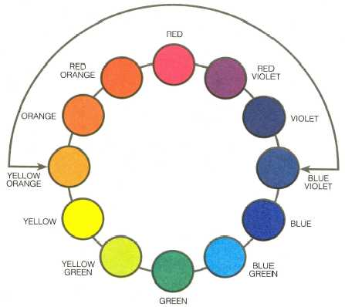
Color Schemes
Analogous Colors
Colors that sit side by side on the color wheel and have a common hue are called “analogous”
Examples: Violet, red-violet, red, and red-orange all have red in common.
Greek: Ana = according to, Logos = proportion

Slide 17
Color Schemes
Complementary Colors
When a pair of high-intensity colors are placed side by side, they seem to vibrate.
It is difficult to focus on the edge where the complements touch.
Traditional compliments are blue/orange, red/violet, and red/green.
Can pair any two colors that are opposite each other on the color wheel.

Slide 18
Color Schemes
Color Triads
A color triad is composed of three colors spaced an equal distance apart on the color wheel.
The contrast between the triad colors is not as strong as that between complements.

Slide 19
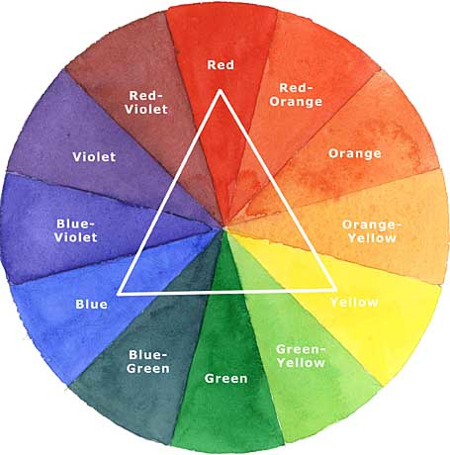

Slide 20
Color Schemes
Split Complements
The pairing of one hue with the hues on each side of its complement
Example: Red is paired with blue-green and
yellow-green

Slide 21
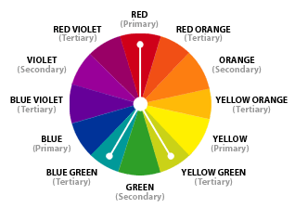

Slide 22
Understanding the Nature and Uses of Color
Paint
All paints are made of three things: pigment, binder, solvent
Pigment: Finely ground, colored powders that form paint when mixed with a binder.
Binder: A material that holds together the grains of pigment in a form that can be spread over a surface.
Solvent: The liquid that controls the viscosity (thickness) of the paint.

Slide 23
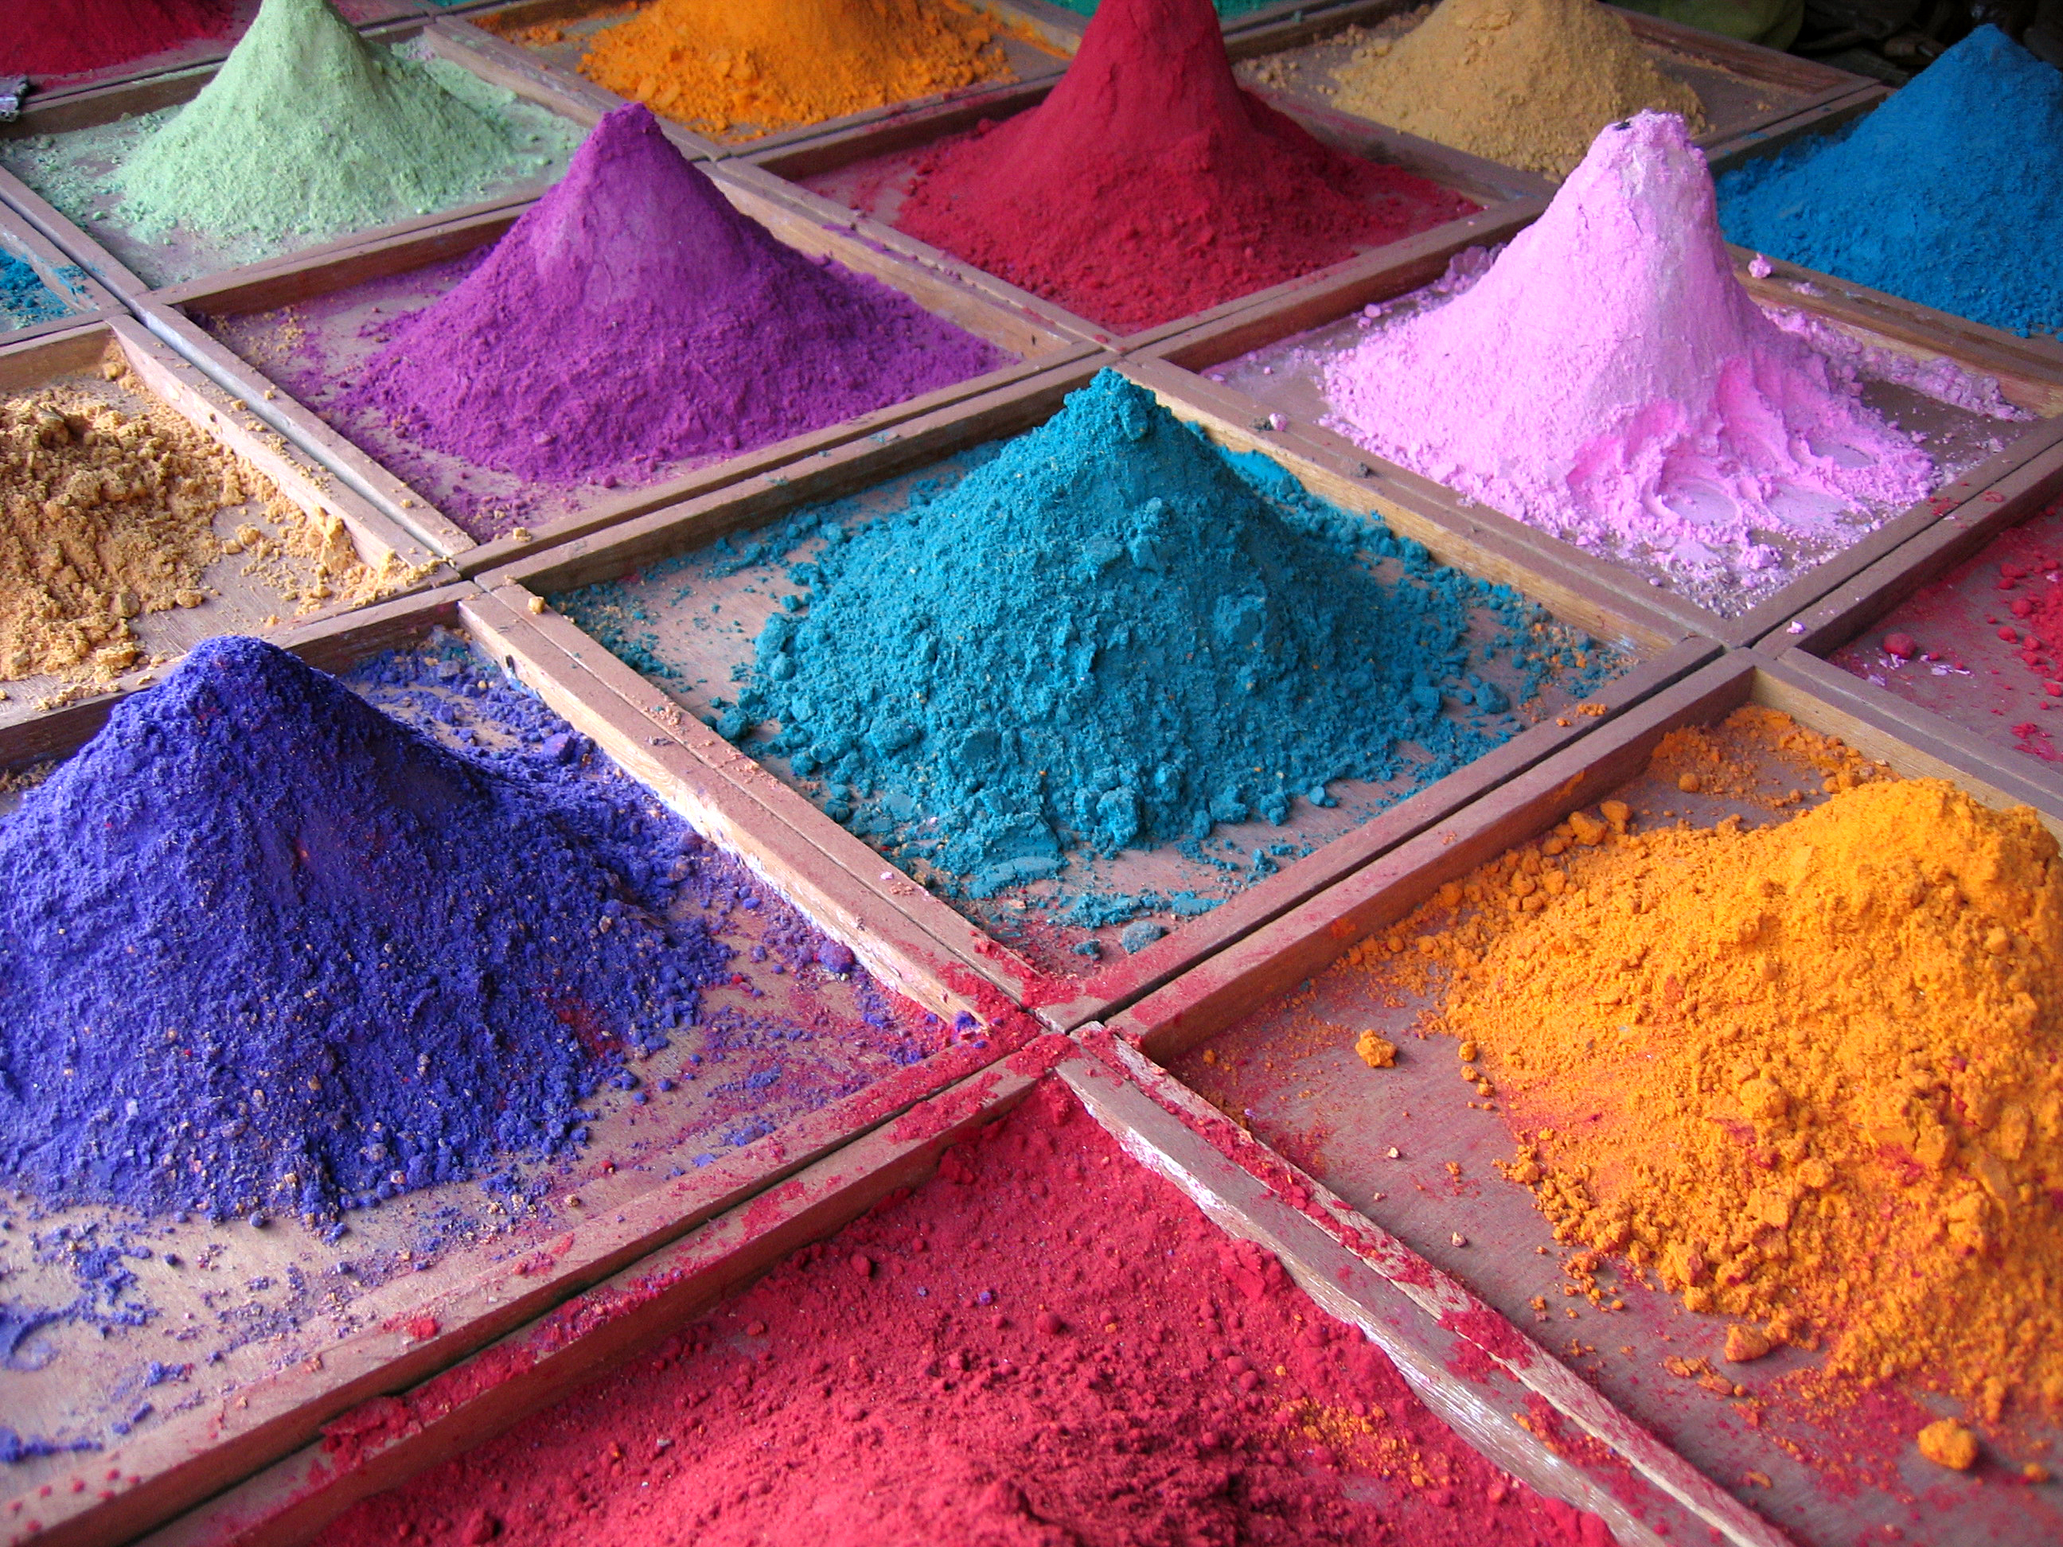

Slide 24
Expressive Effects of Color
Local Color
The color an object appears to be (green grass, blue sky, yellow sun).
Optical Color
The color that results when a true color is affected by unusual lighting or it’s surroundings (context).
(e.g. incandescent light, sunlight, florescent light)
This is the color that our eyes actually perceive and is much more complex than local color.

